Slide 1
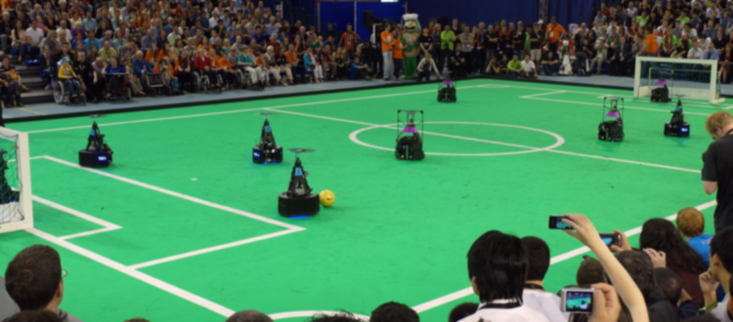
Stakeholder meeting- AutoRef
01/03/2024
Quinten Swaan, Project Manager
Department of Mathematics and Computer Science, EngD. Mechatronic Systems Design

Slide 2
Agenda
Goal: update on progress.
Planning
Risks
Validation
Sensor system
Ball out of play
Last touch
Summary
14:00 – 14:05
14:05 – 14:10
14:10 – 14:20
14:20 – 14:30
14:30 – 14:40
14:45 – 14:55
14:55 – 15:00

Slide 3
Deliverables
Mission: “To observe the match and make autonomous, unbiased decisions based on the soccer robot rules that can be communicated to teams and viewers. ”
Robustness
Adaptability
Performance
Progress
Follow RoboCup MSL rules
Accurate
Real-time
Objectivity
Continuity
Consistent decisions
Safety
Showing proof
Communication
Interests
Challenging
Sending decisions
Personal learning goals

Slide 4
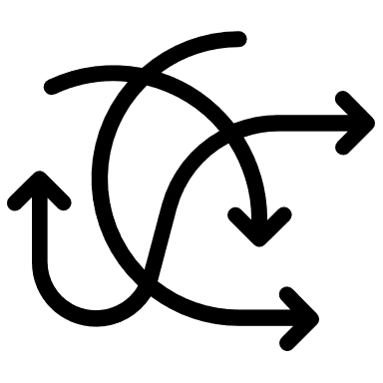




Deliverables
Which team touched the ball the last time before the ball went out of field while the game was in play?
Communication to the referee about the decision above.
Motivation
Difficult for human referees
Objectivity
Challenging and interesting
Challenging
New feature
Progress
Building on BOOP
Continuity
Assistant to referee
Communication

Slide 5

System context diagram
RefBox
RoboCup MSL Rules & Regulations
Game state
Human referee
System
BOOP?
Decision
Developers

Slide 6
Deliverables
End presentation.
Technical report.
Codebase.
Demo, showcasing our system.

Slide 7
Risks
Robustness
Bias
Security
Edge cases
Trust
Validation and verification
Implementation
Sensing accuracy
Edge cases
Occurrence
Validation and verification
Sensing accuracy
Implementation
Trust
Bias
Robustness
Security
Severity

Slide 8
Work Breakdown Structure
WBS
Concept Approval
System Architecture Review
System Implementation
Literature Review
Feasibility Study
Rules Book Summarization
Decision Stories
Decision Trade-off Matrix
Requirements and Specifications Review
User Needs
Requirements Definition
Extract Technical Specifications
Defining Project Scope
System Functionalities
Preliminary Design Review
Critical Design Review
Subsystems Deployment
Subsystems Integration
Verification & Validation
Verification Review
Validation Review
Documentation Approval
Presentation & Demonstration
Project Closure
Project Delivery

Slide 9
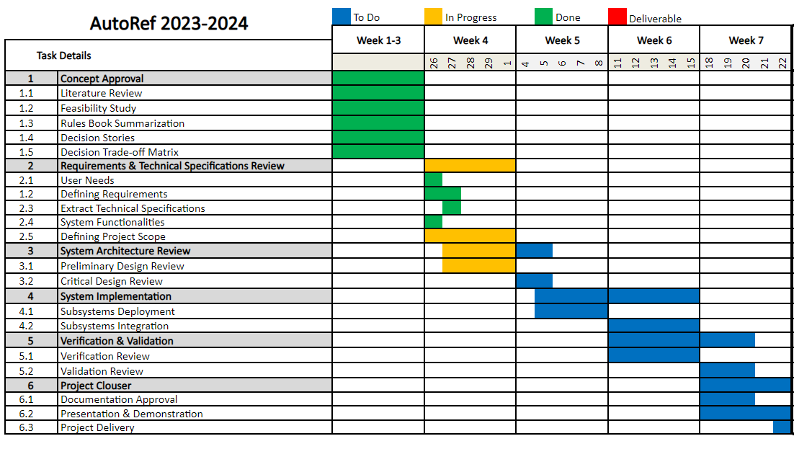
Planning

Slide 10

Functional requirements and specifications
Arjun, Joseph and Naheed

Slide 11
Functional requirements
Ground Truth
Time for Decision Making
Distinguish Last Touch
Detect Ball out of Field
Change in Game State
Communication to Referee
Frames per Second
Zero-Trust
Time Stamps
Transparency

Slide 12
Functional requirements
Time for Decision Making
Distinguish Last Touch
Maximum Distance Error
Operational Time
Change in Game State
Communication to Medium
Live data streaming
Zero-Trust
Time Stamps
Transparency

Slide 13
Ground truth
The stakeholders expressed that we stick to the order of things, processes then requirements then specifications and then solutions. And in order to define the requirements, we need to set the stage for a ground truth.
For the ground truth, it was requested that we rely on how a human referee makes decisions. But a human referee makes decisions in the real world which is not virtual.
Why do I take the time to dedicate an entire slide to ground truth? It is because we had to delve into the solution space on a cursory level to decide on how to define a touch, but there is a virtual world in which a touch is defined the same way it is in the real world.
Assume that we virtualize the real world, and even though we don’t need to actually do it, it’s good to have it as a sort of thought experiment, and it can be done with the OptiTrack and photogrammetry.
Now we use this thought experiment as the basis for what follows.

Slide 14
Time for decision making
The Assistant Referee (AR) can make the combined decision (ball out of play and last touch) in real-time in less than 1 second.
Reason: Based on discussion with Tech United and requirements of the previous year.

Slide 15
Distinguish last touch
AR can distinguish who touched the ball last with desired accuracy at least as good as human, 70% correct decision
References:
55% to 85% accurate on average for a match,
Brazilian referees by De Oliveira et all (2011),
Physical Performance and Decision Making in Association Football Referees: A Naturalistic Study

Slide 16
Maximum distance error
AR is allowed a ±1.5cm error in distance between objects
Reason: The Goal-Line Technology has an accuracy of ±1.5 cm.

Slide 17
Operational time
AR must ensure operational time of 2 hours.
Reason: The Goal-Line Technology has an operational time of 6 hours for a 1.5 hour game, which yields a safety factor of 4, incorporating the same here, we get 2 hours.

Slide 18
Change in game state
The latency of the signal which reflects the change in game state to the AR should be 150ms maximum.
Explanation: Suppose that the referee stops the game using the interface provided by RefBox. The signal should reach the AR within 150ms.
To reduce the false detection of the decision, if the ball is already out of play.

Slide 19
Communication to Medium
AR can communicate the decision it made to the medium in 250ms.
Reason: This is the human reaction time to a visual stimulus.

Slide 20
Live data streaming
AR should receive inputs from the playing field with a minimum frequency of 20 frames per second. (20 Hz)
Reason: The number is taken from the previous year’s document.

Slide 21
Zero-trust
AR should receive data from independent sensors and not from the robots playing the match.
Reason: We don’t trust the data from the teams.

Slide 22
Time stamps
The sensors the AR receives the data from must come with a timestamp, else a timestamp has to be associated with them.
Reason: Transparency for fair decision-making. Also, it’s not unreasonable to expect a timestamp.

Slide 23
Transparency
AR should be able to walk us through the decision making process if questioned.
Reason: First, since the project is in the software domain, a well-commented code should do that. Second, it is supposed to be fair to the participating teams.

Slide 24
THANK YOU
Arjun, Joseph and Naheed

Slide 25
Validation objectives
Validating the functional requirements
Real-world scenarios
Comparison to human referees
Ground truth
Statistical Analysis

Slide 26
Setup
Initial Preparations
System Setup
Independence Verification
Real-world Scenario
2 vs. 2 match at Tech United field
Human referees assisted by the autoref system
Edge cases
Input Data Validation
Recording and ground truth analysis

Slide 27

Analysis methods overview
Statistical Metrics
Accuracy
Confusion Matrix
F1 Score
Comparison to Human Referee
Human-like Decision Making
Overall Performance

Slide 28
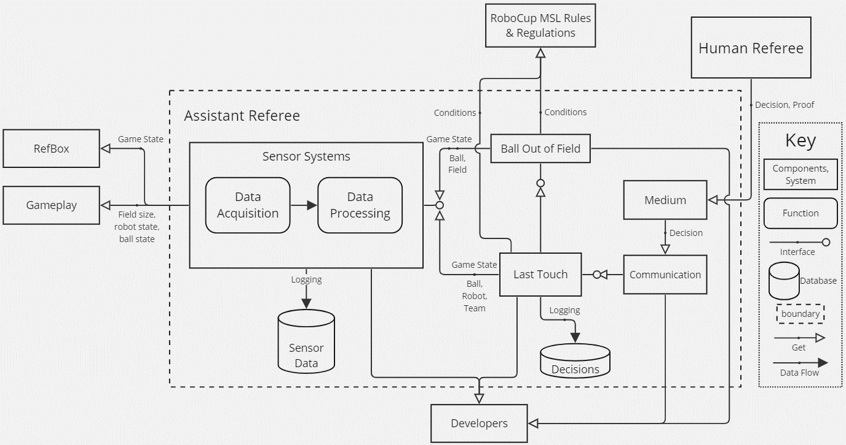
System architecture

Slide 29
Summary

